Slide 1
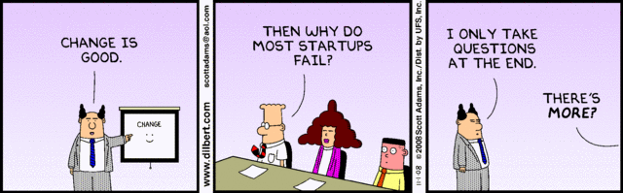
Configuration Management (managing change)

Slide 2
Starter Questions...
Which is more important?
reliability and stability
unrestrained progress
Why is change potentially dangerous?
What causes configuration problems?
multiple developers
multiple releases
components used in multiple products
changing requirements
etc...

Slide 3
Change is inevitable.
AND
Change creates
confusion.
BUT,
Confusion is NOT inevitable.

Slide 4
Outline for Tonight
"Baselines"
CM Repository and Config Tools
CM Plan
Much of this Software Configuration Management presentation
is based on Chapter 27 of Pressman's
Software Engineering: A Practitioners Approach 6th Edition

Slide 5
Goals of CM
5 of 21
Identify Change
Report Changes to people who Need to Know
Control Change
Stability vs Progress
Ensure Change is Properly Implemented

Slide 6
What Changes?
Software Code
source code
object code
Tests
Data
Documents
SRS
designs
project schedules
test plans, test results
…

Slide 7
Key Concept: "Baseline"
7 of 21
"A specification or product that has been formally reviewed and agreed upon, that there-after serves as the basis for further development, and that can be changed only through formal change control procedures."
IEEE Std 729
Standard Glossary of Software Engineering Terminology

Slide 8
Baselines
8 of 21
Establishment of a baseline is a milestone.
Before that milestone, changes can be made informally.
Once reviewed and accepted, the product becomes an established baseline. Everyone proceeds using that version, which is located in a central repository.
Therefore, further change requires formal review, notifications, etc.

Slide 9
Baseline - Standard Change Process
9 of 21
Change Request is made (see next slide)
Request is Approved or Denied
"Check Out" the item(s)
Make Changes
Testing or Reviews
formal review of design changes,
regression testing of modules, etc
Review the Change Order
Notify all Dependencies
when baseline change will occur
what changes were made to baseline
"Check In" the new baseline

Slide 10
Template for Baseline Change Requests
10 of 21
Name, Date, yadda yadda
Type of change
Goal of making the change
Priority / Urgency
Detailed description of the changes
Expected Effects
Timetable for making changes, testing, release,
Estimated Costs

Slide 11
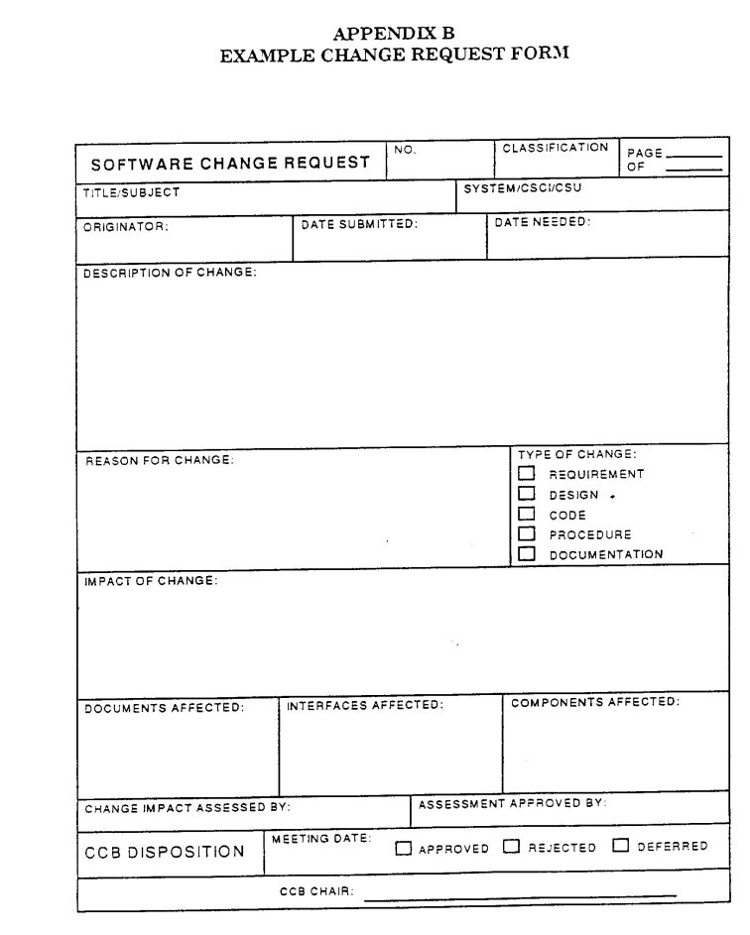
http://satc.gsfc.nasa.gov/GuideBooks/Image4.jpg

Slide 12
Version Numbering
12 of 21
Item After Modify Build 1 Build 2 Release 1…
Test Plan 0.0.0 (original version)
0.0.1 --> 0.1.0
0.1.1 --> 0.2.0 --> 1.0.0
Module 1 0.0.0 --> 0.1.0 --> 0.2.0 --> 1.0.0
Module 2 0.0.0
...
0.0.8 --> 0.1.0
0.1.1 --> 0.2.0
0.2.1
0.2.2 --> 1.0.0

Slide 13
Question...
How do we keep track of all these versions, dependencies among components, approval records, etc. etc. etc.?
Use Good CM Tools
Have a Sound CM Procedure

Slide 14
CM Repository - Common Jargon
14 of 21
Configuration Item
standard term for entities in the CMR
CM Objects
CM probably organized as object-oriented database
Basic Objects
Aggregate Objects

Slide 15
CM Tools - Necessary Features
Versioning
Dependency Tracking!!!
Audit Trails!!!
Reporting of Changes
Supports the Change Rules
Requirements Tracing
Repository arranged as "basic objects" and "aggregate objects"
Supports both Linear evolution and Trees

Slide 16

Parts of a CM Plan
16 of 21
Process Elements
collection of procedures that define approach to change management
Component Elements
set of tools and file management system that enable access to and management of items
Construction Elements
tools that automate the construction of software, test suites, etc.
Human Elements

Slide 17
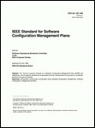
IEEE / ANSI 828
17 of 21
Standard for Software Configuration Management Plans
1. Introduction
a) purpose
b) scope
c) definitions and acronyms
d) references
2. Management
a) organization
b) SCM responsibilities
c) interface control
d) SCMP implementation
e) policies, directives, procedures (naming conventions, version designations, problem report process)
3. SCM Activities
a) configuration identification
b) configuration control (change history, review authority, read/write control, member identification)
c) configuration status accounting (status of change requests, status of approved changes, …)
d) audits and reviews
4. Tools, Techniques, and Methodologies
5. Supplier Control
6. Records Collection and Retention

Slide 18
IEEE 1042
18 of 21
Guide to Software Configuration Management
Defines terms such as baseline and version
Discusses configuration management as a management discipline and its role in the engineering process
Includes checklists of issues for sections of the SCMP (IEEE Std 828)
Includes four complete examples of SCMPs

Slide 19
CM Audits
19 of 21
% of unapproved changes
% of Change Orders completed on schedule
% of affected Configuration Items that were not checked
% of properly documented Configuration Items
number of CM Process Failures

Slide 20
Summary
Change is inevitable.
Baselines are milestones of a configuration item.
Use a tool or set of tools to control change
access control
version tracking
etc
Adopt a Change Management Plan

